Slide 1

Final Presentation
21Spr07-CWC3DGen: Luis Castaneda, Skyler Penny, Lucas Sottile, Simon Stoner

Slide 2
Introduction and understanding of the project problem
What is our project?
  To create an electric motor to be used as a power generation source for the Collegiate Wind Competition (CWC) wind turbine.
  Being able to customize the motor in future years to meet their design specifications or requirements.
Client: David Willy
Team Recognition includes a case study with ANSYS that will display our team’s work
Lucas Sottile 11/19/2021 21Spr07-CWC3DGen

Slide 3

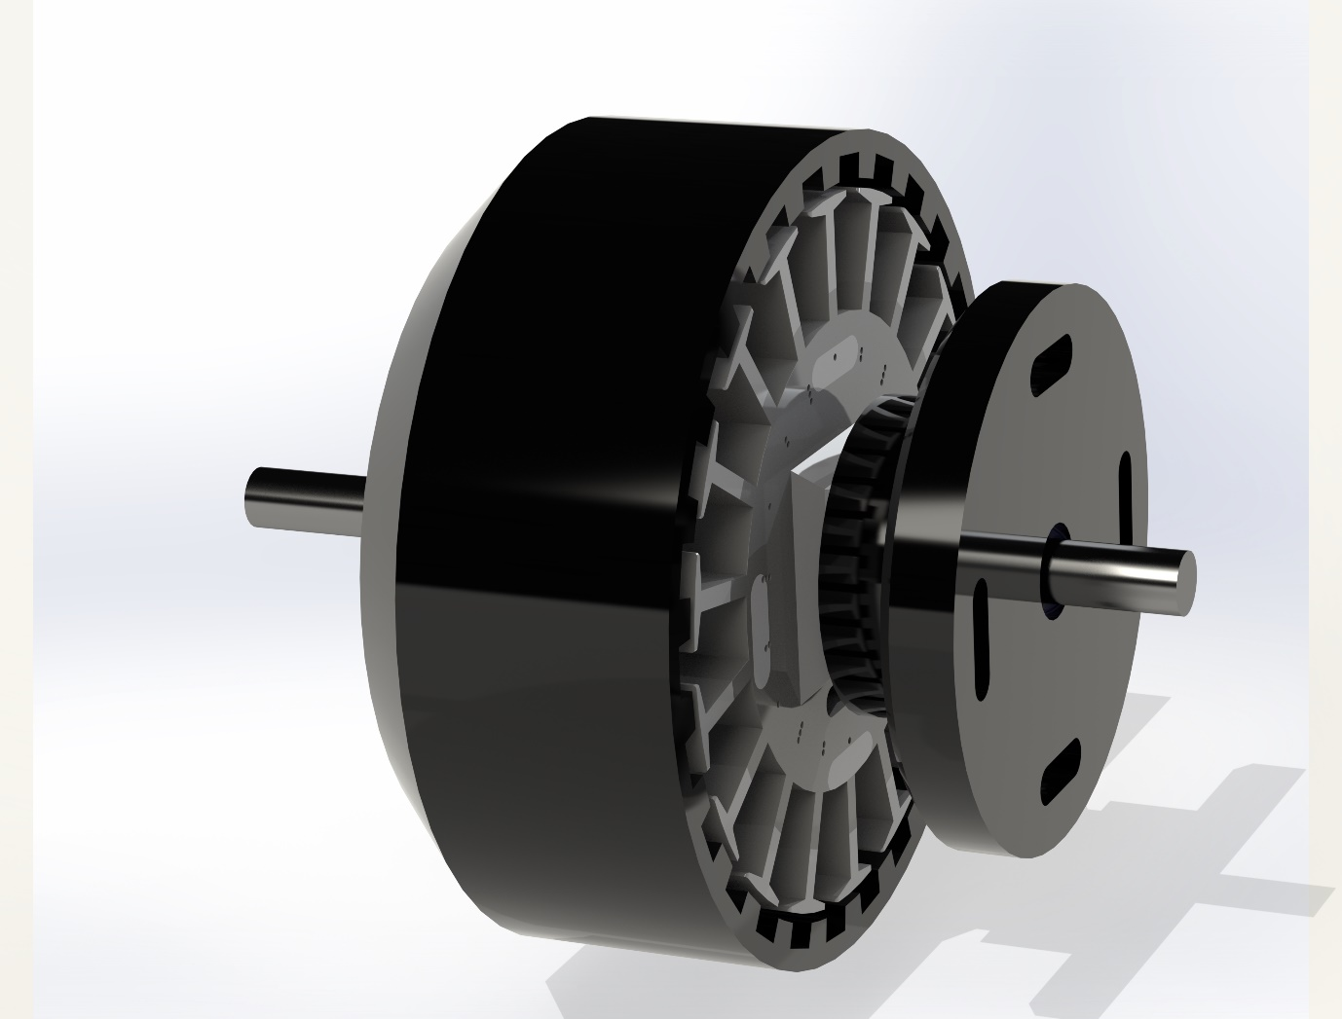
Customer Requirements
Cost within budget [5]
Durable and robust design [4]
Reliable design [5]
Safe to operate [5]
Within optimal power range [4]
Reasonable voltage output [3]
Withstand speed s of operation [4]
Must be a brushless motor [4]
Must integrate with CWC wind turbines [2]
Multiple components must be 3D printed [5]
Minimal (almost zero) cogging torque [3]
Standard mounting pattern [4]
Compact size [4]
Figure 1: Final design render
Skyler Penny 11/19/2021 21Spr07-CWC3DGen

Slide 4
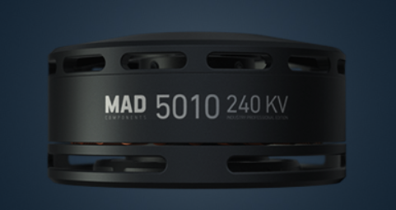
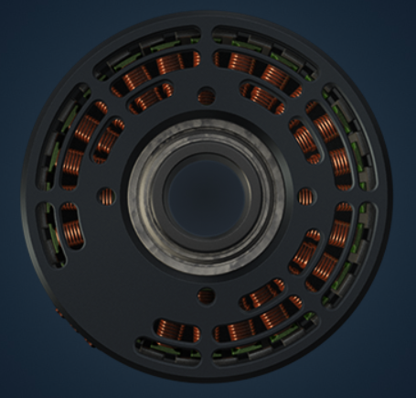
Engineering Requirements
Table 1: Engineering requirements
1. (R ) | Reliability (10^6 Revolutions)
2. (D) | Durability (> 6000 RPM)
3. (V) | Voltage (<=48 V)
4. (P) | Peak Power (200-400 Watts)
5. (KV) | Power Rating (125-240 RPM/V)
6. (Pr) | Price (<$500)
7. (W) | Weight (<1000 g)
8. (C ) | Current (2.89 A)
9. (Re) | Resistance (166 Ohms)
Specifications for design were collected from the client and comparative outsourced generator models for performance parameters.
MAD 5010: Commonly used by CWC Teams
240 KV
Continuous Power of 330 W
Weight of 170 g
4 x M3 Ø30 mm mounting holes
OD 56mm, Height of 27.6mm
Figure 2: MAD motor profile [1]
Figure 3: MAD motor rear view [1]
Skyler Penny 11/19/2021 21Spr07-CWC3DGen

Slide 5
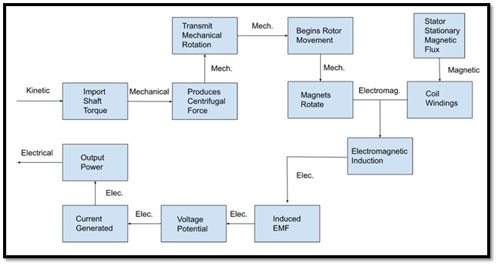
Outer Rotor General Function
Figure 4: Hypothetical design functional breakdown based on first semester findings
Skyler Penny 11/19/2021 21Spr07-CWC3DGen

Slide 6

Design solution to the project problem
The team’s design included an increased ratio of magnets to slots to decrease the cogging torque, increasing the number of windings to counter the material hinderances of performance, and to design the motor for 3D printability. Specifics follow.
Figure 5: Final design render
Lucas Sottile 11/19/2021 21Spr07-CWC3DGen

Slide 7
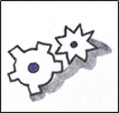
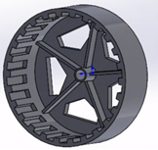
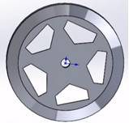
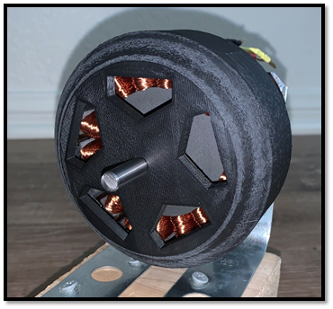
Design Making: Rotor
24 poles
5 pentagonal cut outs to support heat dissipation
65-45mm depth to reduce printing time
Internal ribs support torque of the shaft
Simon Stoner 11/19/2021 21Spr07-CWC3DGen
Figure 6, 7, 8: Rotor designs

Slide 8
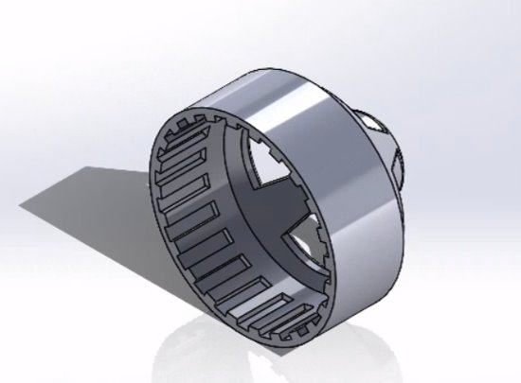
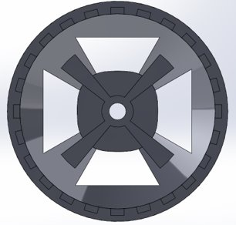
Design Making: Rotor
Figure 9 and 10: Initial stator CAD design views of rear quarter and back
Simon Stoner 11/19/2021 21Spr07-CWC3DGen

Slide 9
Design Making: Rotor
Figure 13: Centrifugal Principle Stress 10,000 RPM Front
Design simulated for 6,000 to 11,000 RPM
Max point of stress tabulated
Calculated stress of simplified version with same material density used for comparison
Stress compared to rotor material strength (Polycarbonate ABS Alloy)
Figure 11: Simulative Process Breakdown
Figure 12: Centrifugal Principle Stress 10,000 RPM
Skyler Penny 11/19/2021 21Spr07-CWC3DGen

Slide 10
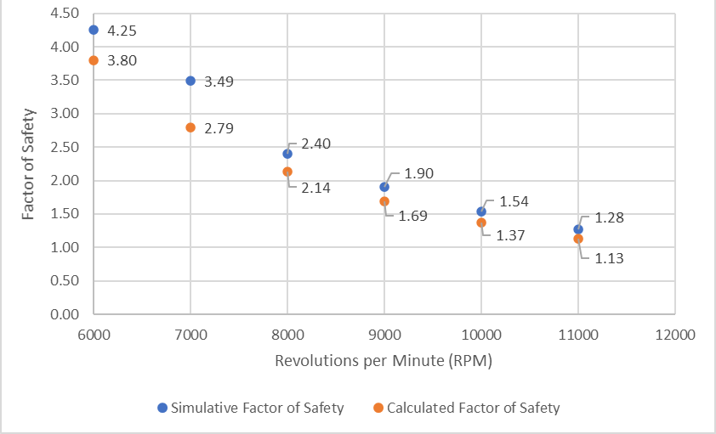
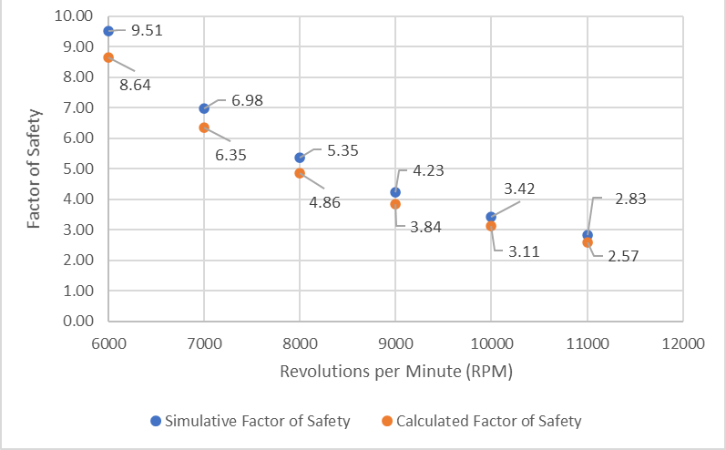
Design Making: Rotor
Figure 14: Rotor 1 Calculated and Simulative F.S. vs. RPM
Figure 15: Rotor 2 Calculated and Simulative F.S. vs. RPM
Skyler Penny 11/19/2021 21Spr07-CWC3DGen

Slide 11
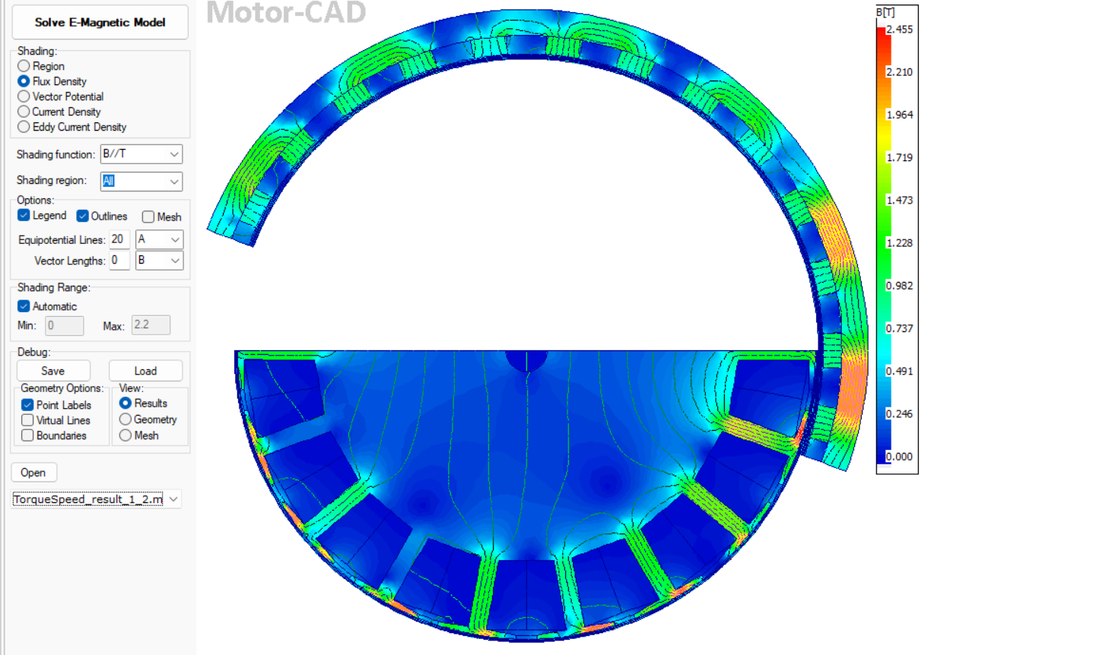
Design Making: Stator
Old Design
New Design
18 Slots-50 windings per slot per phase
60 degree tooth tip angle
3mm slot thickness
Regular PLA
Square slot tooth tip
50% infill
18 Slots-75 windings per slot per phase
10 degree tooth tip angle
2mm slot thickness
Composite PLA
Phase number reference
Central point cutout
Stress reduction improvements
Rounded OD (slot tooth tip)
Increased mesh density-STL
Radially varied infill
Figure 16: FEA of flux density
Lucas Sottile 11/19/2021 21Spr07-CWC3DGen

Slide 12
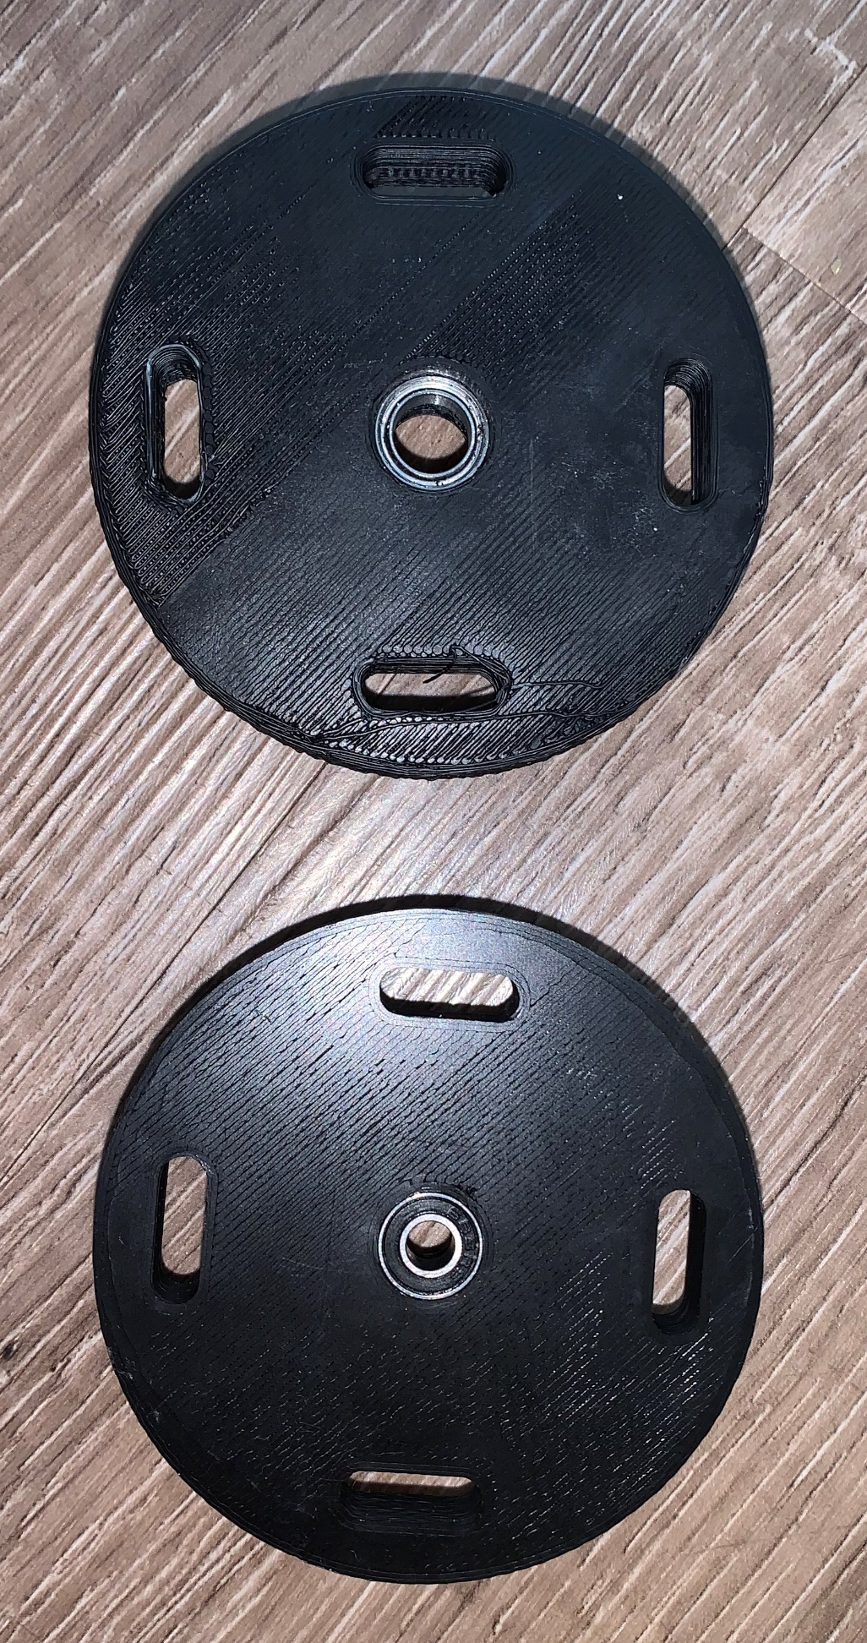
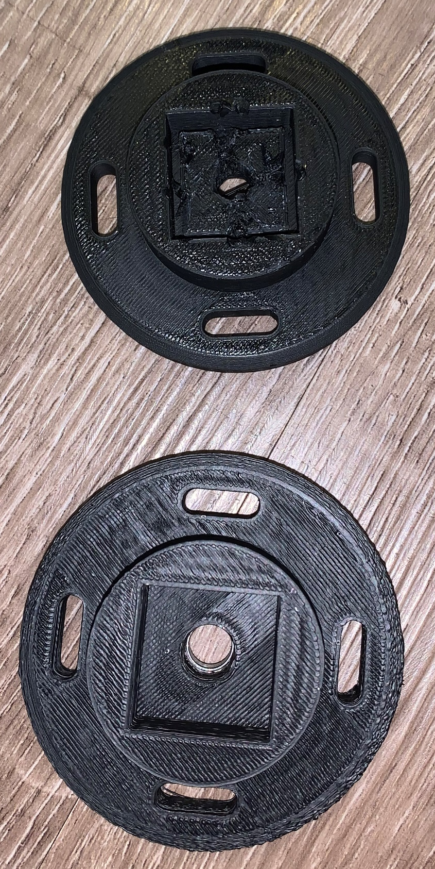
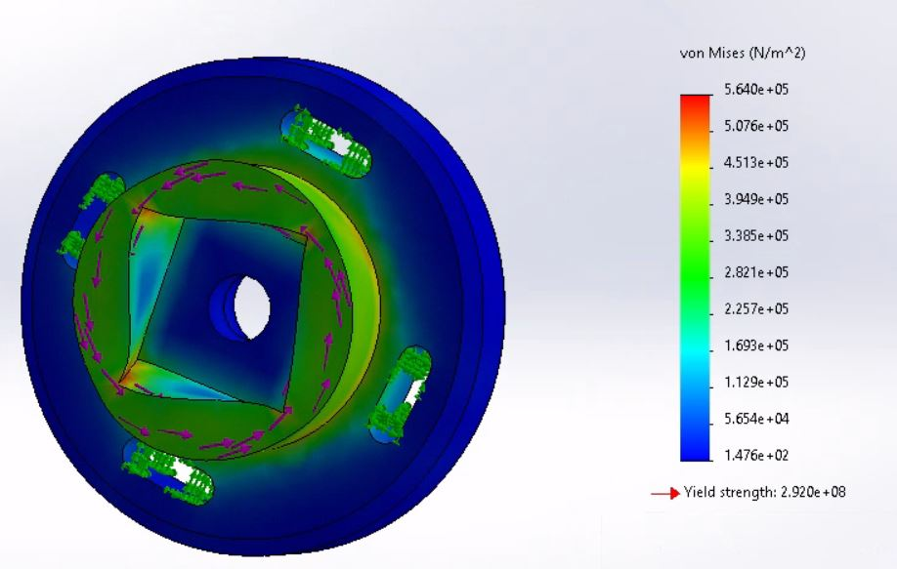
Design Making: Backplate
Initially PLA then polycarbonate ABS blend to increase strength
Added 3mm of thickness to part
4 x 5mm slots of 10mm length for adaptability
MR128ZZ 8x12x3.5mm, high speed industry (ball bearing steel)
Figure 18: Backplate Rear (Top 2nd Iteration)
Figure 19: Backplate Front (Bottom 2nd Iteration)
Figure 17: Backplate Rotational Stress Simulated (3Nm)
Skyler Penny 11/19/2021 21Spr07-CWC3DGen

Slide 13
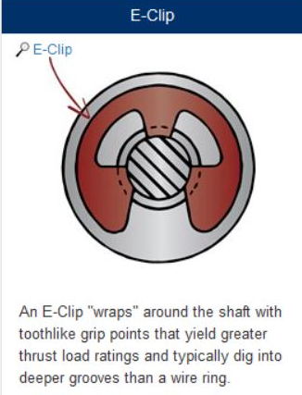
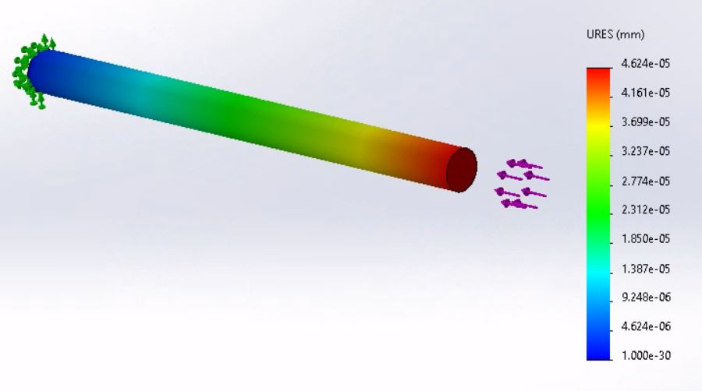
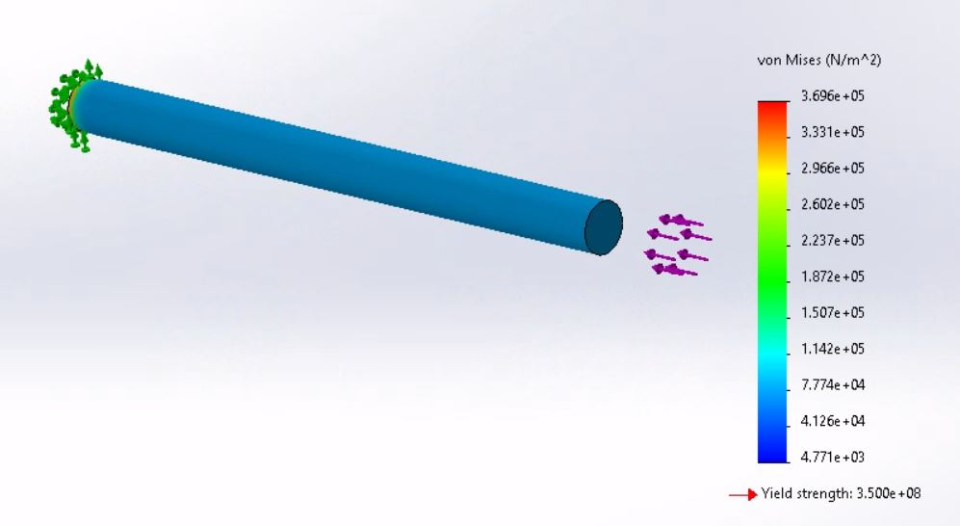
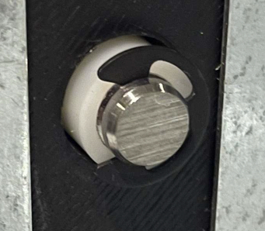
Design Making: Shaft
Black Phosphate 1060 Spring steel 5/16 inch clip
330 lbf. rated thrust force [3]
Shaft 8mm OD hardened steel
First Iteration 5mm shaft found to have negligible deformation as a simply supported beam with weight of rotor and two bearing supports
Actual thrust force of no more than 0.02 lbf (rotor movement forward during operation)
Figure 22: E-Clip Schematic [2]
Figure 20 and 21: 200mm 316 Stainless Steel Hardened Shaft Thrust (3N)
Figure 23: E-Clip on shaft with nylon bushing
Skyler Penny 11/19/2021 21Spr07-CWC3DGen

Slide 14
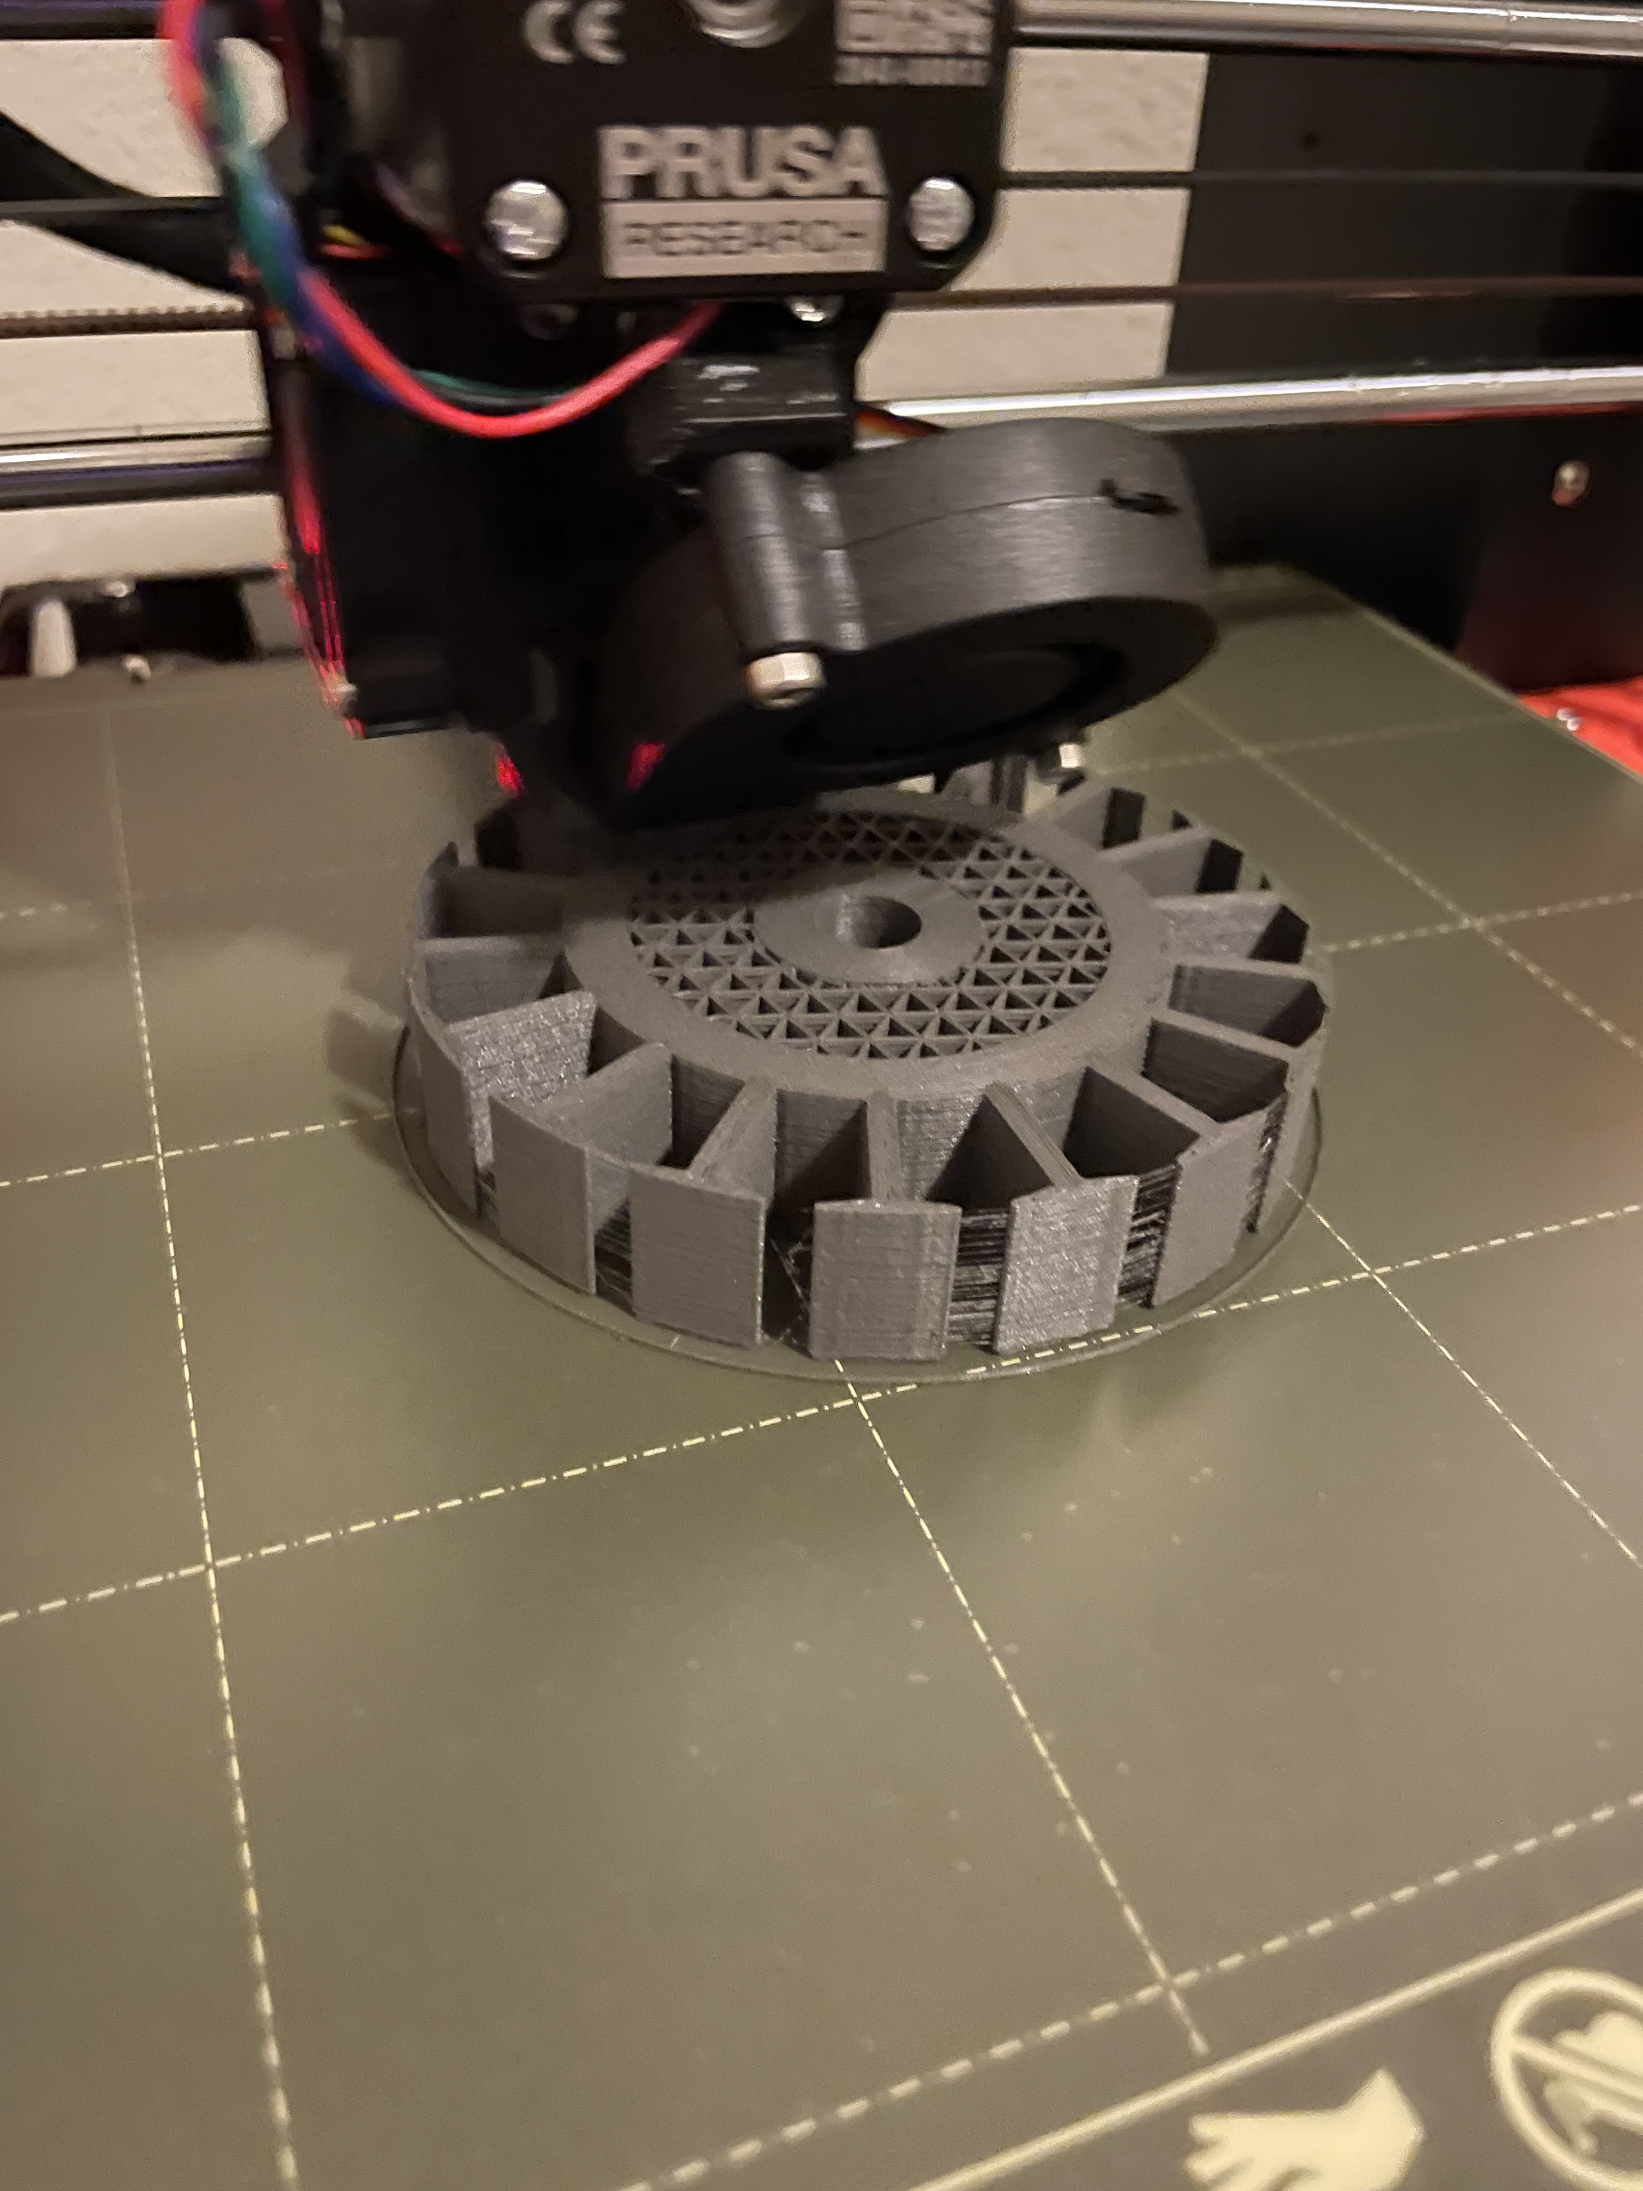
Manufacturing and testing final project solution
Manufacturing of the stator, rotor and backplate were all done with additive manufacturing (3D printing). Percentage of infill varied from 100% to a radially varied infill percentage for the stator.
A Polycarbonate/ABS alloy was used for both the rotor and the backplate due to the increased strength and temperature resistance. A PLA composite was used for the stator to improve performance of the motor.
Modifying print temperatures and bed temperatures was needed to prevent layer separation as well as to reduce warping of the PC/ABS alloy, PC/ABS is also known to shrink more than PLA so a scaled up model was made at 101.5%
Figure 24: Printing of stator
Lucas Sottile 11/19/2021 21Spr07-CWC3DGen

Slide 15
Testing Engineering and Customer Requirements
Table 2: Engineering and customer requirements table
CR | Completion | ER | Completion
Within optimal power range | No | Voltage (V) | No
Reasonable voltage output | No | Power (W) | No
Withstand speed | No | KV (RPM/V) | No
Must be a brushless motor | Yes | cost $ | Yes
Must integrate with CWC wind turbine | Yes | Weight (g) | Yes
Multiple components must be 3D printed | Yes | Current (A) | TBD
Minimal (almost zero) cogging torque | Yes | Resistance (Ohms) | TBD
Standardized CWC mounting pattern | Yes | Reliability (revolutions) | TBD
Compact Size | Yes | Durability (rpm) | TBD
Cost within Budget | Yes
Durable and robust design | Yes
Reliable design | Yes
Safe to operate | No
Luis Castaneda 11/19/2021 21Spr07-CWC3DGen

Slide 16
Meeting Customer Requirements
Missing customer requirements
  Optimal Power Range
  Reasonable voltage output
  Withstand speed
  Safety operation
Missing engineering requirements
  Voltage: <= 48 [V]
  Power: 300-400 [W]
  Kv rating: 125-240 [rpm/V]
  Reliability: 10^6 [revolutions]
  Durability: > 6000 [rpm]
All customer requirements as well as ER 1,2, 3 and 5 completion will be determined by next week when final testing is done on the design.
Luis Castaneda 11/19/2021 21Spr07-CWC3DGen

Slide 17
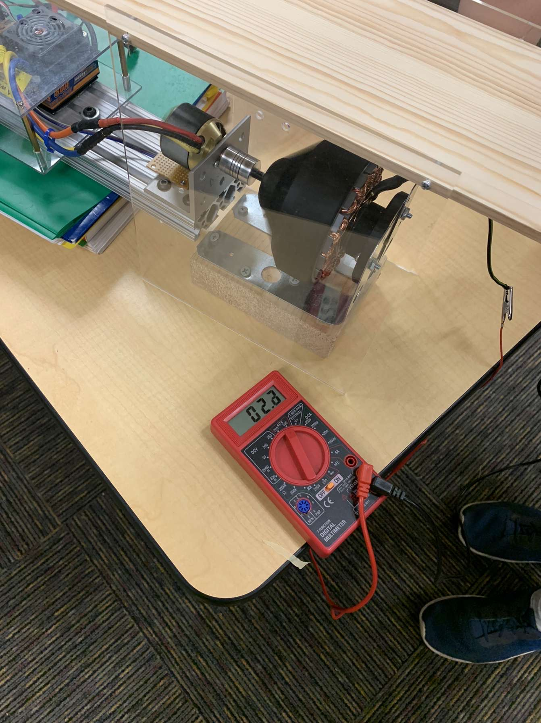
Testing Procedure
Open circuit test
Goal: To determine functionality of generator and measure voltage output
Instruments: Dynamometer, shield, and multimeter
Figure 25: Open circuit testing example
Luis Castaneda 11/19/2021 21Spr07-CWC3DGen

Slide 18
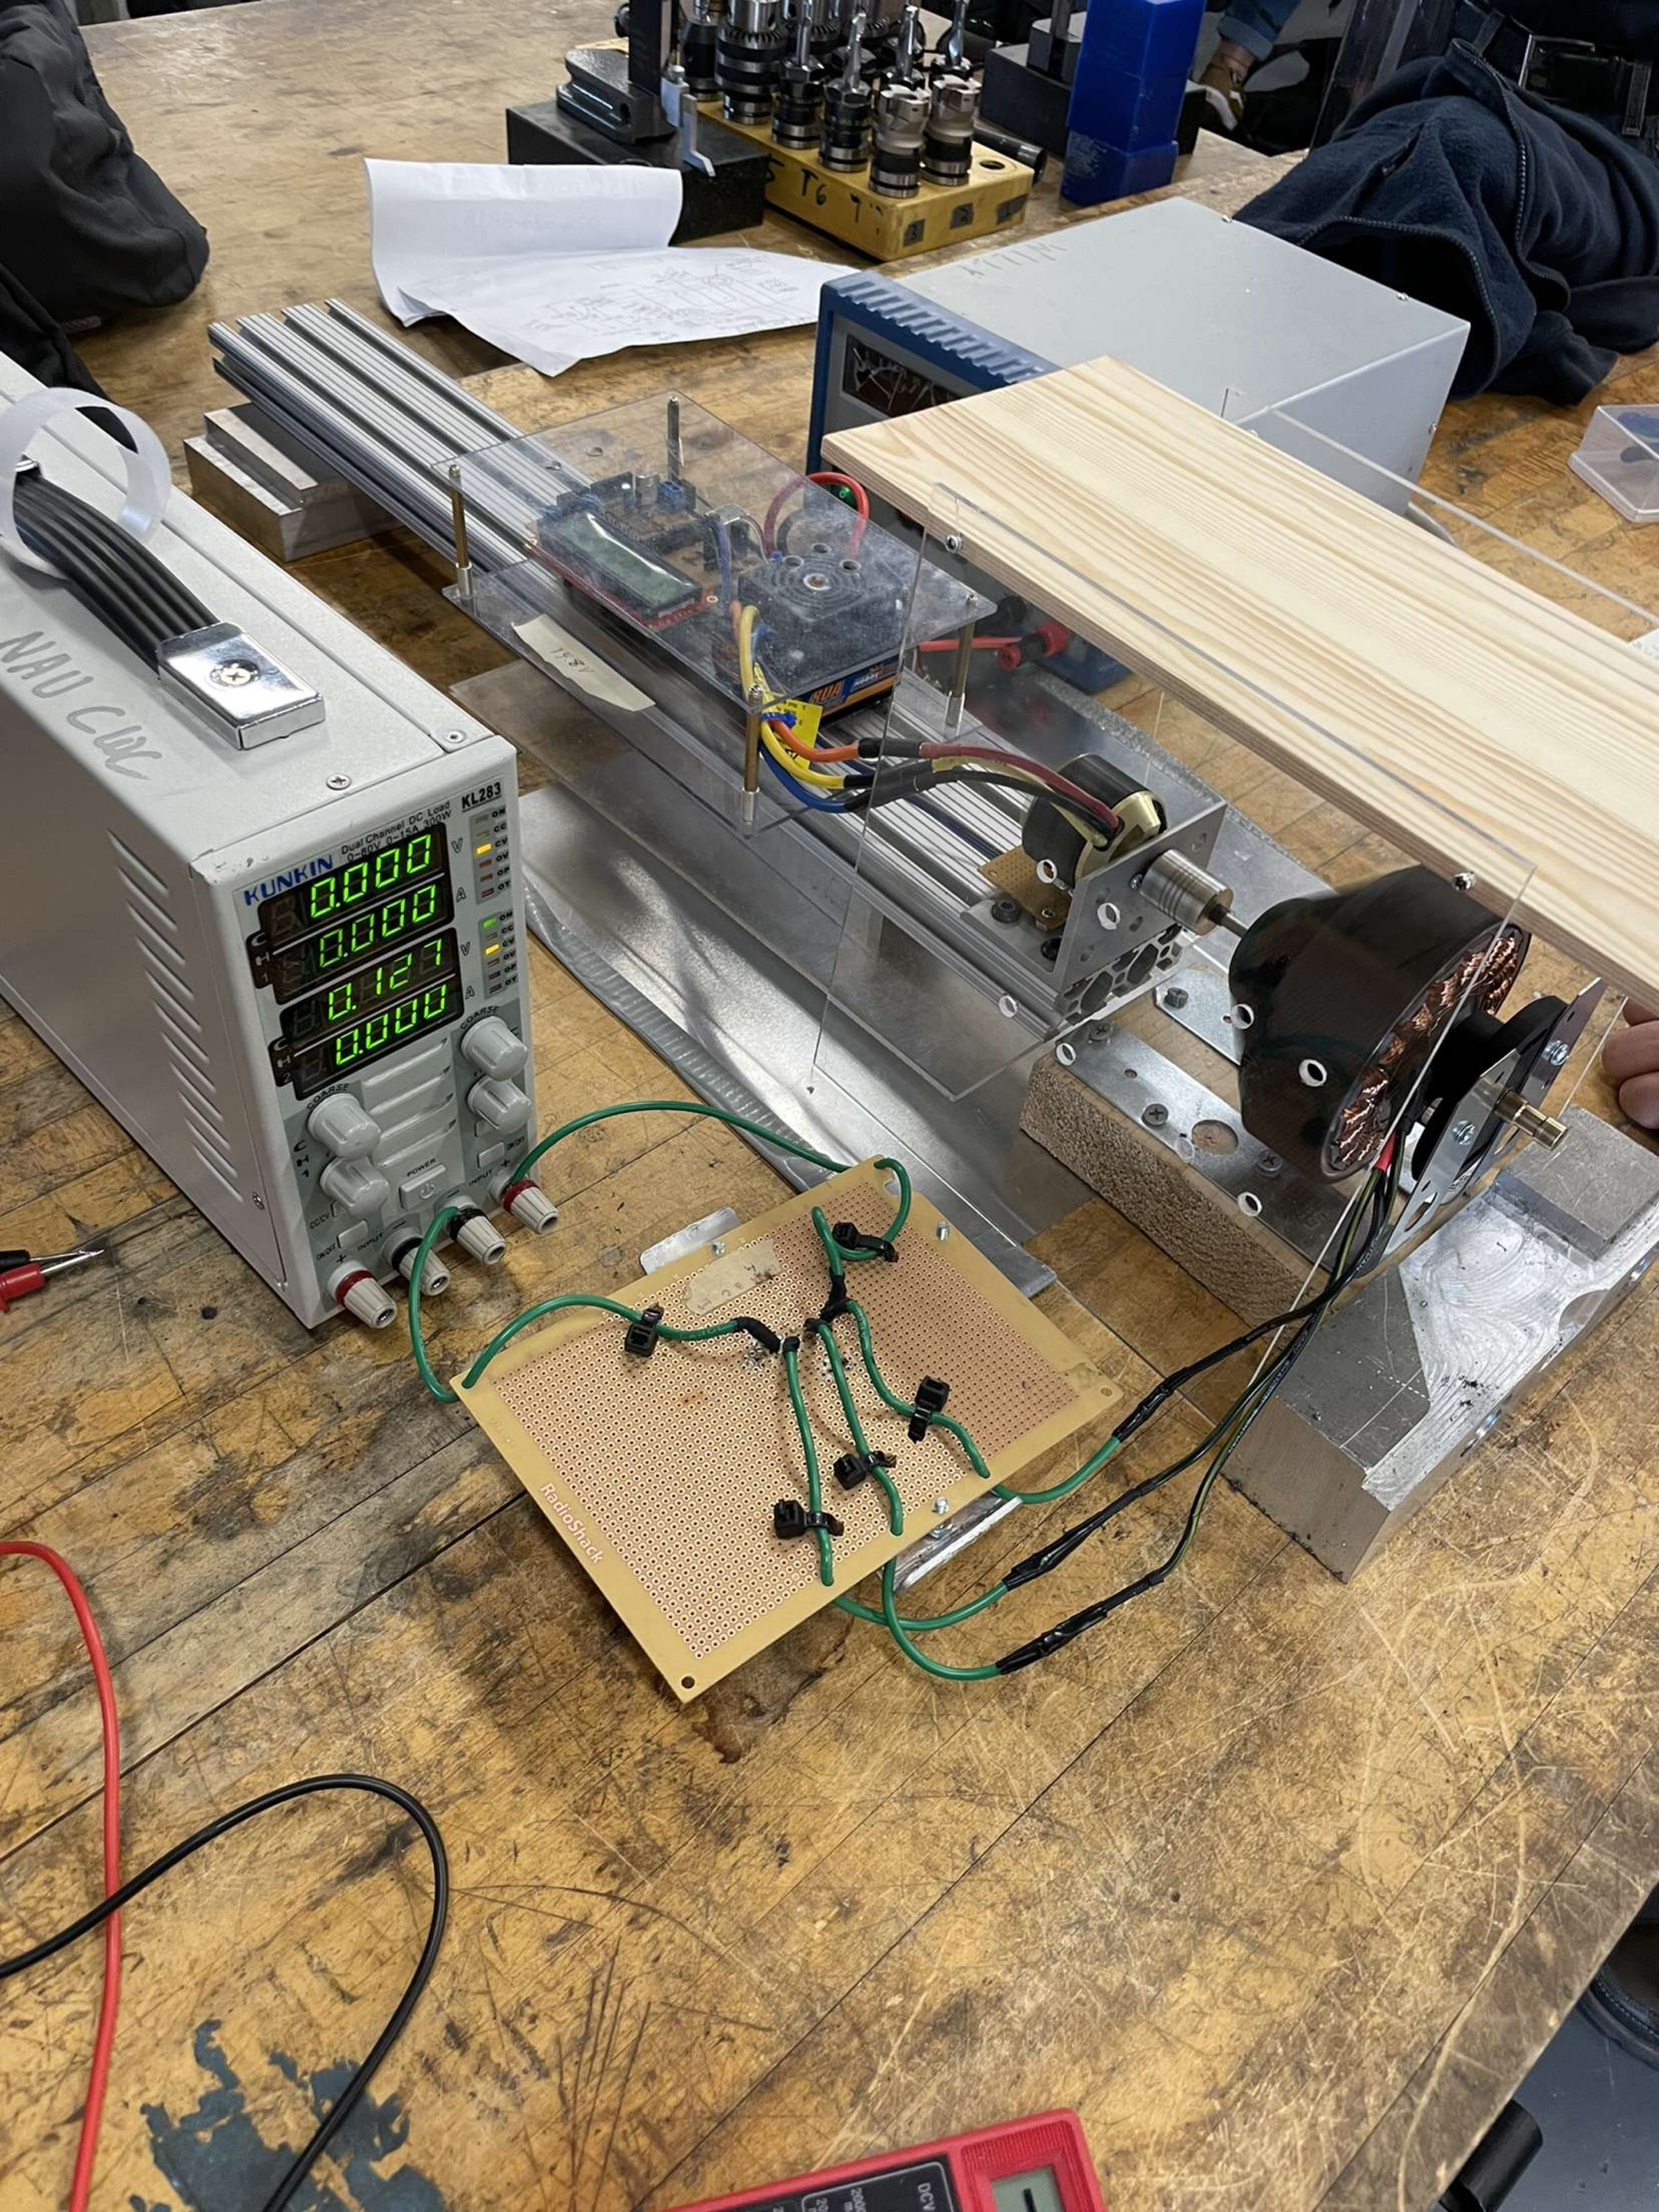
Testing Procedure
Load Test
Goal: To measure electrical parameters under a load
Instruments: Dynamometer, shield, rectifier, dual channel DC variable load machine
Figure 26: Example of load testing
Luis Castaneda 11/19/2021 21Spr07-CWC3DGen

Slide 19

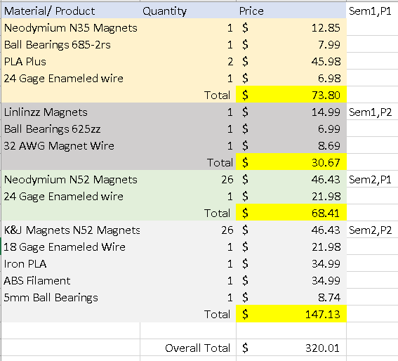
Budget
Table 3: Budget
$500 Budget
Semester 1 total = $104.47
Semester 2 total = $215.54
$179.99 remaining
Simon Stoner 11/19/2021 21Spr07-CWC3DGen

Slide 20
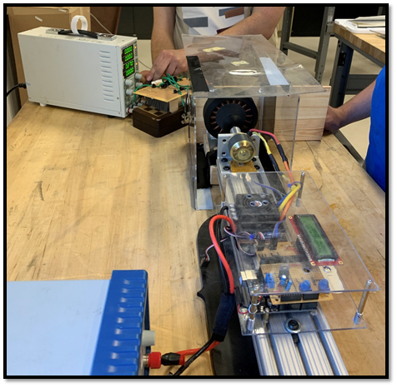
Future work
Further testing : KV rating, operation at optimum Speed
Splitting roles; Simon-CAD Assembly and drawings, Skyler-Poster, Lucas- manufacturing manual, Luis- website
Interdisciplinary and cooperation with CWC Team
Simon Stoner 11/19/2021 21Spr07-CWC3DGen
Figure 27: Load test at machine shop

Slide 21

References
[1] “Mad5010 240KV,” MAD Components, 2017. [Online]. Available: http://madcomponents.co/index.php/mad5010-240kv/. [Accessed: 18-Nov-2021].
[2] M. Glass, “How do I cut an e-clip slot,” Dallas Makerspace Talk, 22-Nov-2016. [Online]. Available: https://talk.dallasmakerspace.org/t/how-do-i-cut-an-e-clip-slot/14541/6. [Accessed: 14-Nov-2021].
[3] “E-Clip,” McMaster. [Online]. Available: https://www.mcmaster.com/retaining-clips/side-mount-external-retaining-rings-6/. [Accessed: 17-Nov-2021].

